Slide 1
Methods to prevent and reduce dampness in masonry

Slide 2


Are electrokinetic methods suitable for the treatment of rising damp?
Yves Vanhellemont, Michael de Bouw, Samuel Dubois
Belgian Building Research Institute (BBRI)
Jan Bolhuis, Barbara Lubelli, Linda Miedema, Rob van Hees
Delft University of Technology (TUDelft)
yves.vanhellemont@bbri.be

Slide 3
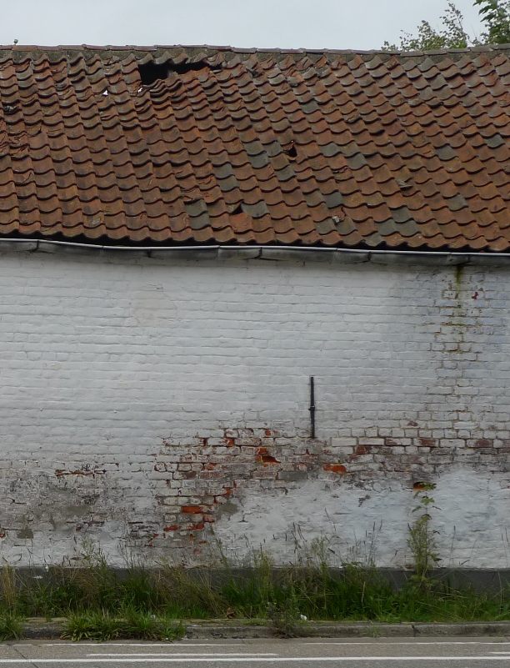
What?
‘electrokinetic dehumidification’
Sometimes also referred to as ‘electromagnetic’ or ‘electrokybernetic’ dehumidification
‘pushing back’ rising damp using proper electromagnetic waves
  ‘wireless’ form of electro-osmosis ?
  ‘changing’ the structure of the water molecule ?
  ‘influenced by earth rays’ ?
yves.vanhellemont@bbri.be

Slide 4
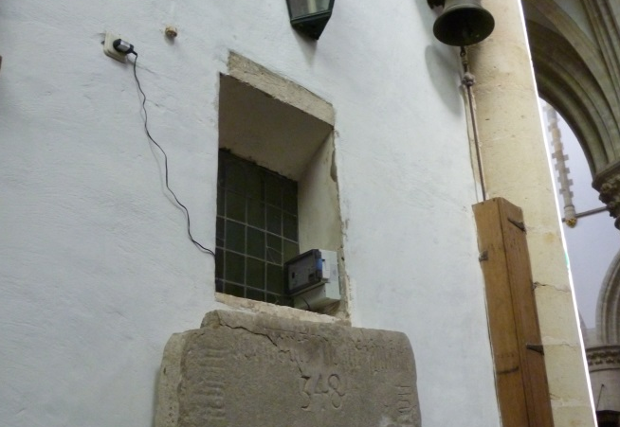
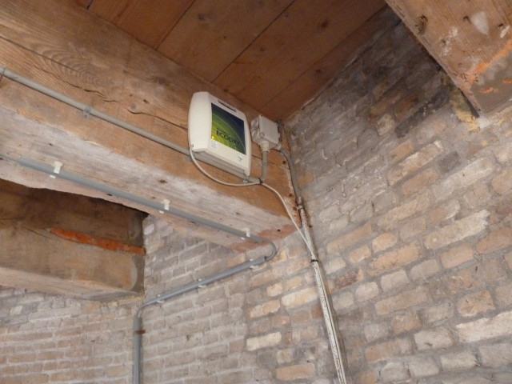
What?
Appearance/characteristics:
Small box, plugged into a normal electricity socket
Action radius, typical 10 meter, around the box
As long as the box is plugged in, the system works.
Necessity of drying? Some suppliers say yes, other disagree
yves.vanhellemont@bbri.be

Slide 5
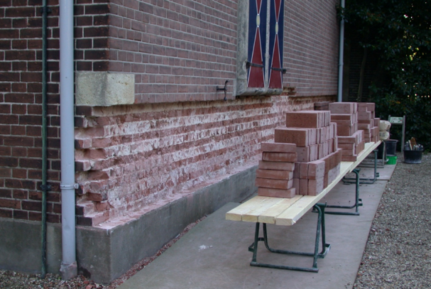
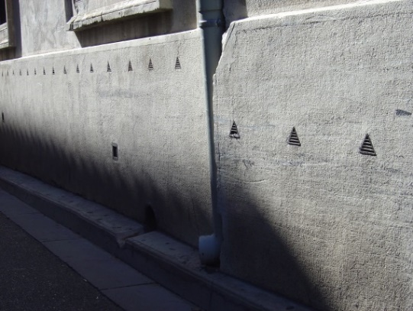
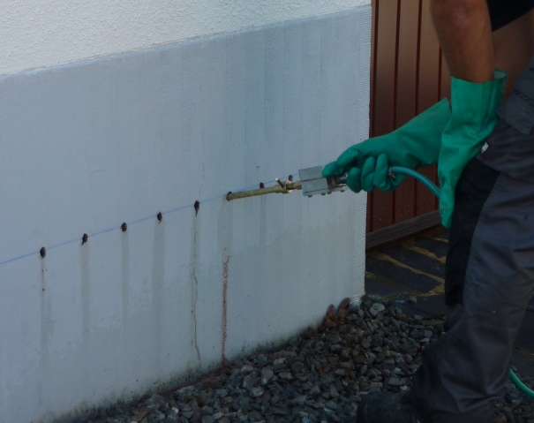
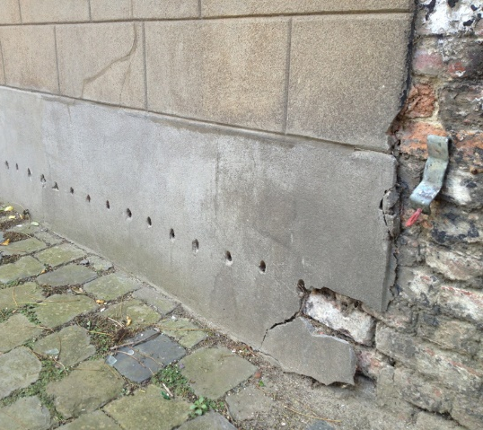
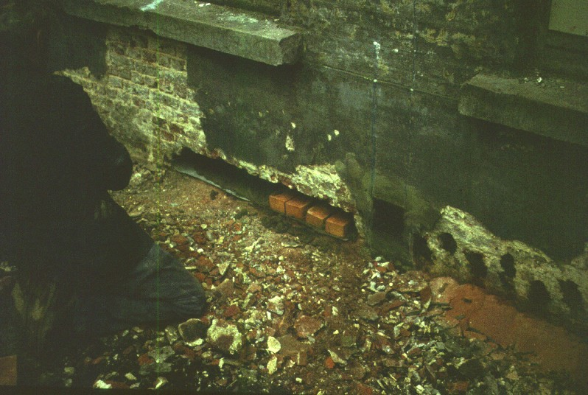
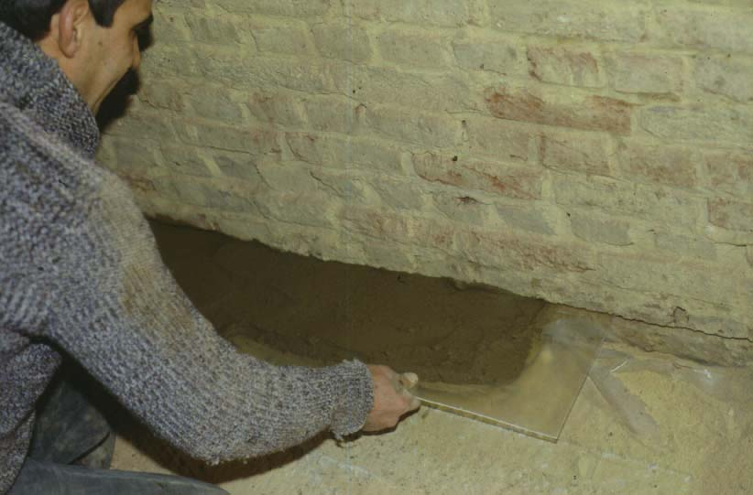
Advantages
Quick installation
Hardly any damage to historic materials (except for some holes to attach the box to the wall)
Almost fully reversible! Which is not the case with almost all other existing techniques
But what can be expected regarding performance?
yves.vanhellemont@bbri.be

Slide 6
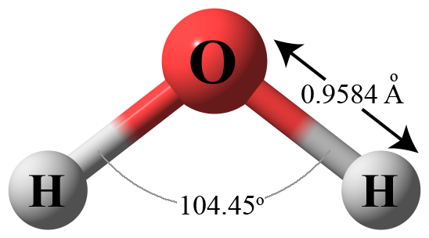
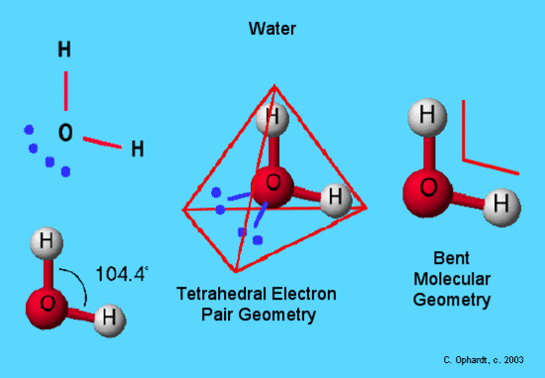
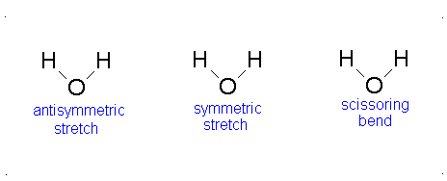
Theoretical basis
Specific tetrahedral structure of the water molecule (dipole structure)
NOT a consequence of interaction between water molecules (as sometimes suggested, in analogy with polarisation between nearby molecules, resulting in so-called Van der Waals forces)
This structure causes special physical properties of water, such as high evaporation energy, high surface tension, good solvent for many salts, higher volume for ice, …
This structure can not be changed permanently → it is only possible to cause vibration around this tetrahedral state, but averaged, this tetrahedral structure remains unchanged. Therefore no possibility to reduce the surface tension of water, and other linked physical properties.
yves.vanhellemont@bbri.be

Slide 7
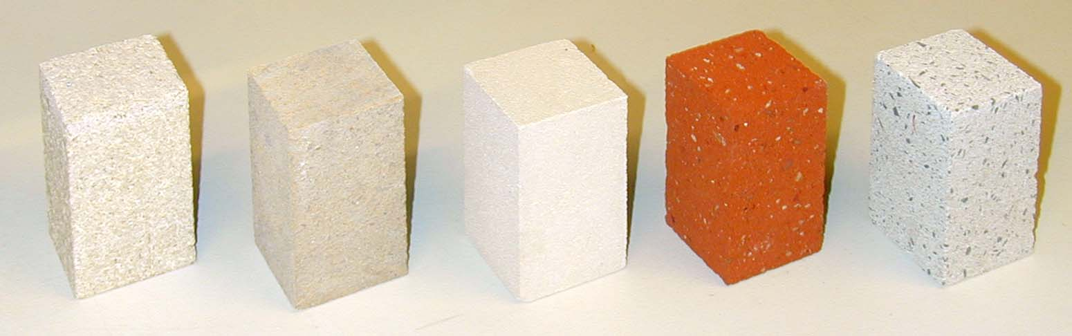
Capillary structure of stone, animals and plants
Euville Massangis Savonnières brick artificial sand-limestone
(14%) (14%) (32%) (32%) (30%)
yves.vanhellemont@bbri.be

Slide 8
Capillary structure of stone, animals and plants
Blood vessels → possible influence by electromagnetic systems….
Remark: fluid transport in plants and animals not (entirely) by capillary forces
yves.vanhellemont@bbri.be

Slide 9
Theoretical basis - conclusions
Influence of an electromagnetic field on the movement of watermolecules (dipoles)? Most probably none.
It is highly improbable to change the properties of a water molecule with electromagnetic waves, and therefore the physical properties of water. It would be more likely that the proper electromagnetic waves would heat up the water, and possibly even desintegrate the water molecules.
If capillary movement could be influences by electromagnetic waves, it could be dangerous to apply this technique in the vicinity of animals, humans or plants.
But: the proof of the pudding is in the eating!
Especially because there does not seem to be a concensus about the working principle of such devices.
yves.vanhellemont@bbri.be

Slide 10
Case-studies
Method: for a specific building, suffering from rising damp.
Characterisation of the moisture distribution in the wall (in function of depth and height):
  Sampling at different heights and depths
  Drying of the samples at constant temperature (for instance 60°C)
  Weighing of the samples, resulting in the Moisture Content (MC).
  Conditioning of the samples in an atmosphere of 95% RH, until equilibrium.
  Weighing of the samples resulting in the Hygroscopic Moisture Content (HMC)
Determining the evolution of the moisture distribution, after application of a method against rising damp.
If the moisture content decreases after installation of the device (and in a reference zone without treatment, it does not decrease), and this decrease continues, then one could conclude that the dehumidification is effective.
yves.vanhellemont@bbri.be

Slide 11
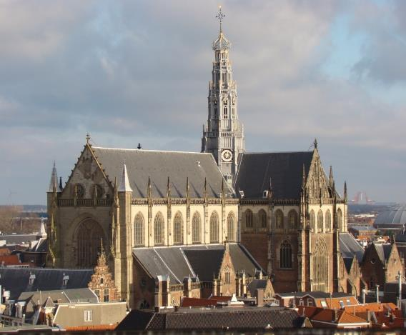
Saint Bavo Church, Haarlem (NL)
One of the largest churches in the Netherlands
Built between 1370 and 1520
Most recent restoration in 1980-1985
yves.vanhellemont@bbri.be

Slide 12
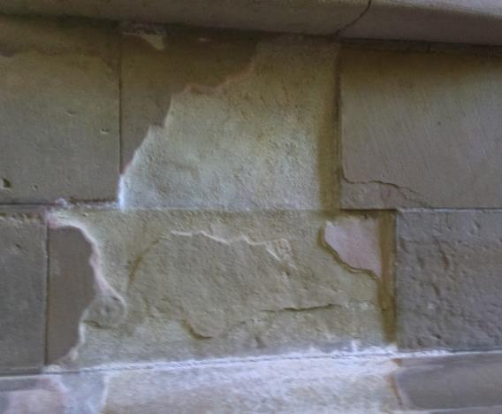
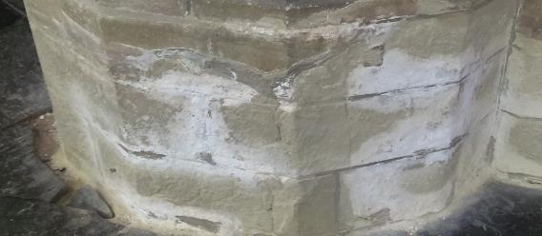
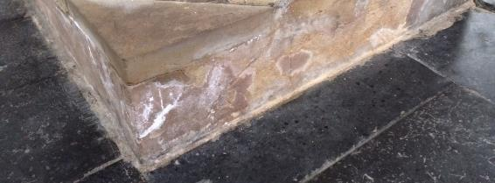
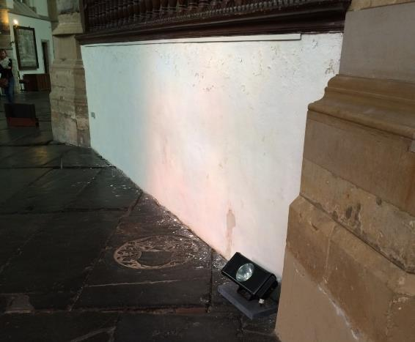
Saint Bavo Church, Haarlem (Nl)
yves.vanhellemont@bbri.be

Slide 13
Saint Bavo Church, Haarlem (Nl)
System applied in 2015 in the southern transept
Measurements:
  Before application (January 2015)
  12 months after application (January 2016)
  Planned: 24 months after application (January 2017)
Measured at 3 locations
  Including a reference location outside the area of influence of the device
yves.vanhellemont@bbri.be

Slide 14
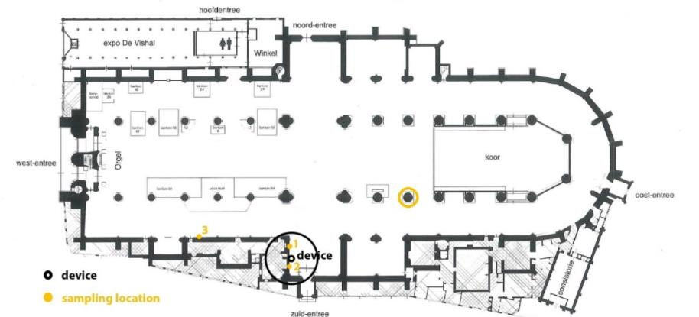
Saint Bavo Church, Haarlem (Nl)
yves.vanhellemont@bbri.be

Slide 15
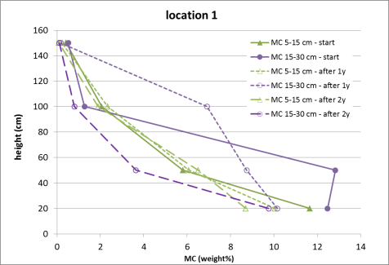
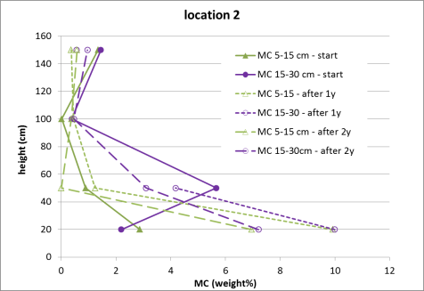
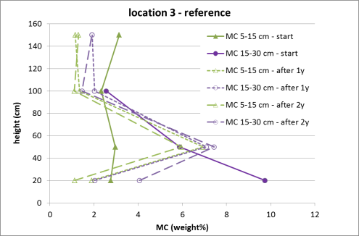
Saint Bavo Church, Haarlem (Nl)
Results in the reference zone show that there are some fluctuations in MC, which is normal
Location 1:
  a slight initial decrease in MC at depth 15-30 cm, but remaining (too) high, even after two years after the installation.
  At depth 5-15 cm, hardly any evolution in MC
Location 2:
  Increase of the MC, for both depths.
yves.vanhellemont@bbri.be

Slide 16
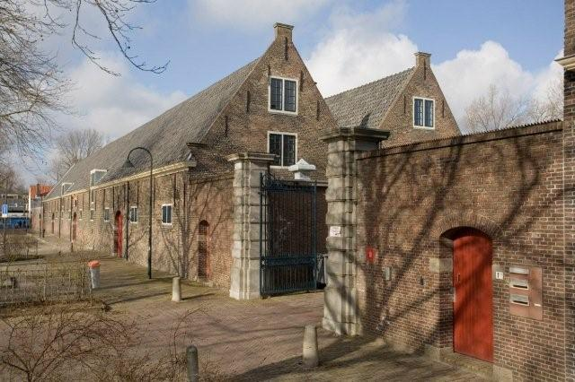
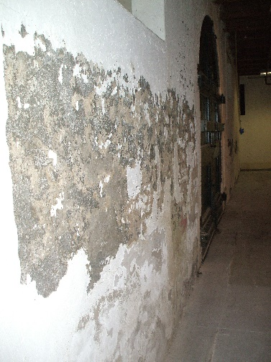
Paardenmarkt, Delft (Nl)
Former artillery warehouse
Constructed in the 17th century
Constructed in brick masonry, and subject to rising damp and salt crystallisation.
yves.vanhellemont@bbri.be

Slide 17
Paardenmarkt, Delft (Nl)
Installation of two systems
Measurements:
  Before application
  10 months after application
yves.vanhellemont@bbri.be

Slide 18
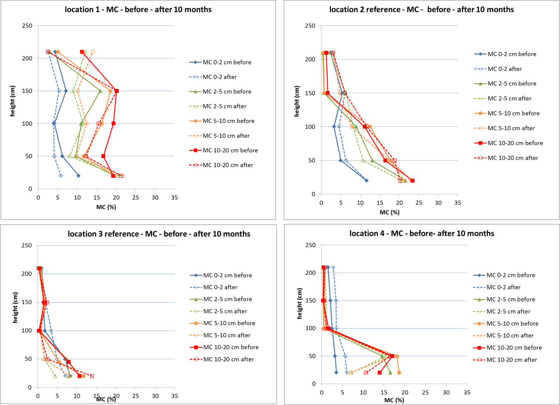
Paardenmarkt, Delft (Nl)
yves.vanhellemont@bbri.be

Slide 19
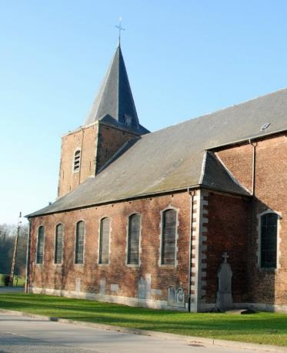
Saint Martin church, Genappe (BE)
Parish church for the commune of Ways, constructed in 1767
Listed in 1963
Structure mainly brick masonry (with a lower part in lime stone), wall thickness about 87 cm
Humidity problems due to proximity of a river, and high groundwaterlevel.
yves.vanhellemont@bbri.be

Slide 20
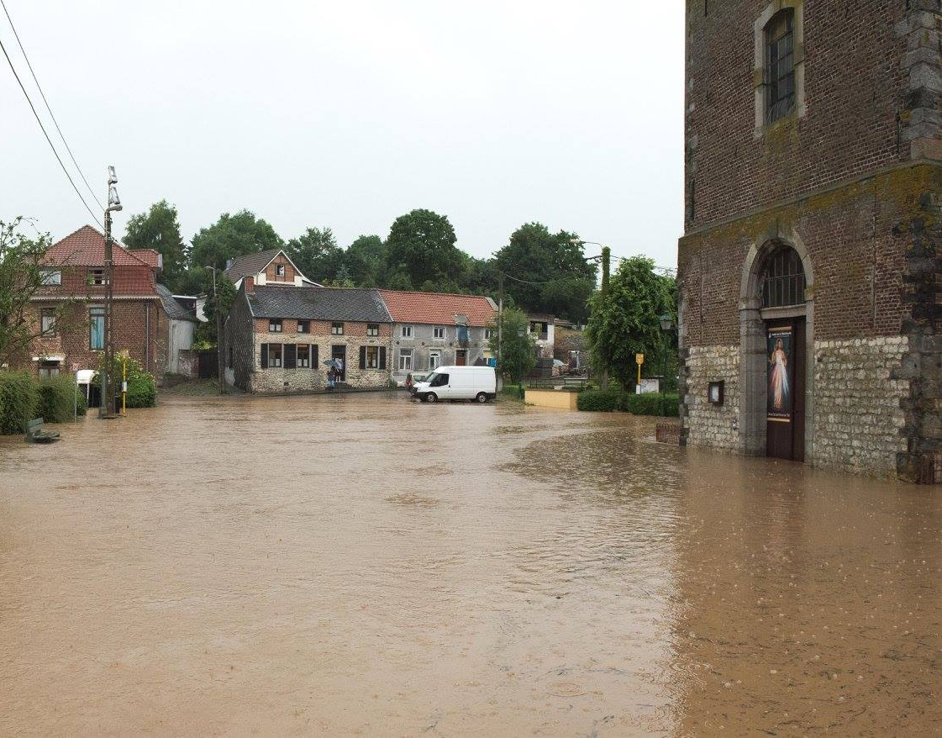

Slide 21
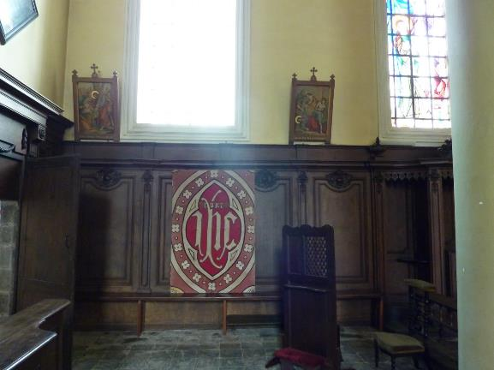
Saint Martin church, Genappe (BE)
No significant damage to the walls.
Significant damage to the wooden panels (deformation, moulds, fungi)
Unpleasant moist inner climate
yves.vanhellemont@bbri.be

Slide 22
Saint Martin church, Genappe (BE)
Resulting in a very un-even moisture distribution: behind the wall panels, the humidity is much higher than on the outside
Wooden wall panels
87 cm
Humidity behind the wall panels
inside
outside
Humidity outside
June 11, 2018
22
yves.vanhellemont@bbri.be

Slide 23
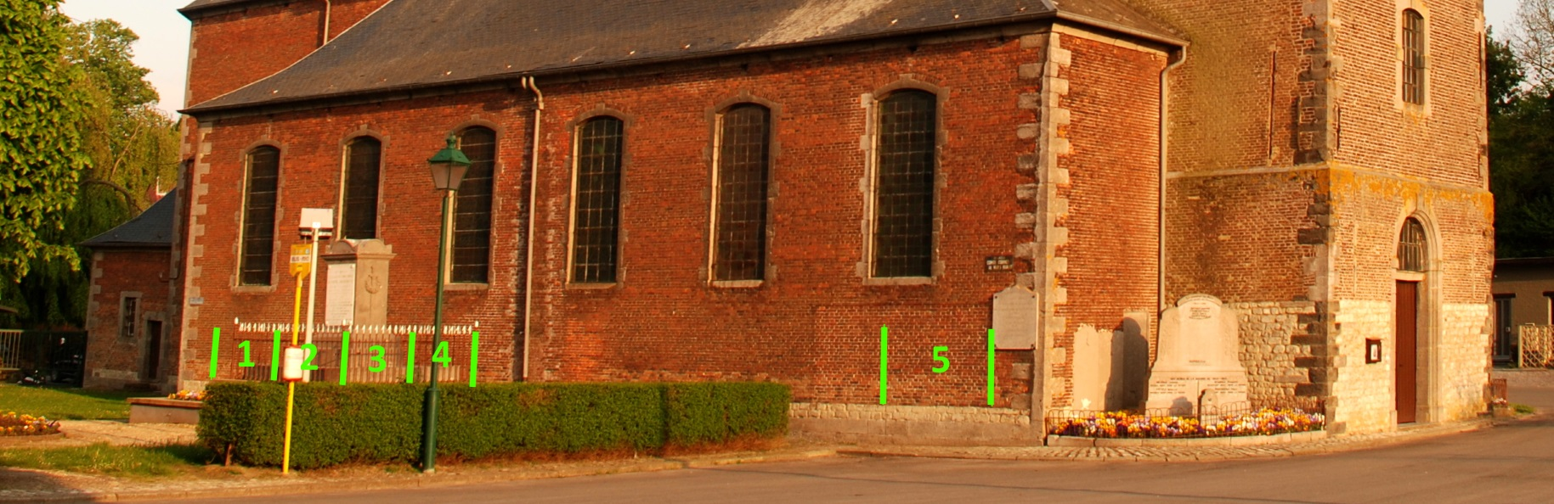
Saint Martin church, Genappe (BE)
Product based on siloxanes and aluminiumstearate, dissolved in an organic solvent (zone 1)
Two injection cremes, concentrations between 65 and 80% (zones 2 and 3)
Product based on siloxanes and silanes, emulsion in water (zone 4)
electrokinetic system (zone 5)
yves.vanhellemont@bbri.be

Slide 24
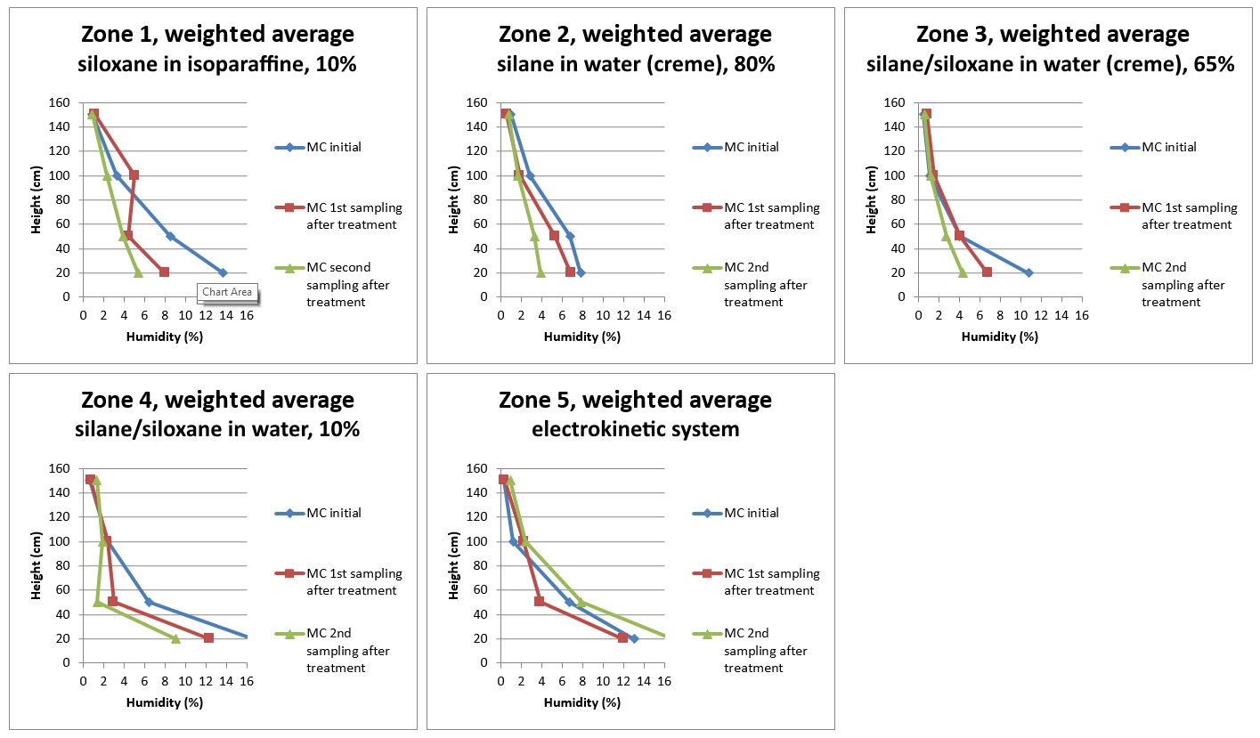
Saint Martin church, Genappe (BE)
Systematic decrease of MC in all zones, except for zone 5, where MC is even increasing.
yves.vanhellemont@bbri.be

Slide 25
Conclusions
Electrokinetic dehumidification systems show lots of potential advantages, of which the reversibility is of great importance for application in heritage buildings.
Its application is evidently only useful if the method is effective.
Theoretical arguments indicate at least ‘problems’ with the performance of the method. These arguments are not conclusive, because the working principle behind the method is nog completely clear, and there is disagreement amongst suplliers.
If the method would work, then it could be expected to be dangerous for humans, animals and plants.
Several test setups have shown that the method is no worthy alternative for other types of interventions against rising damp.
yves.vanhellemont@bbri.be

